Slide 1
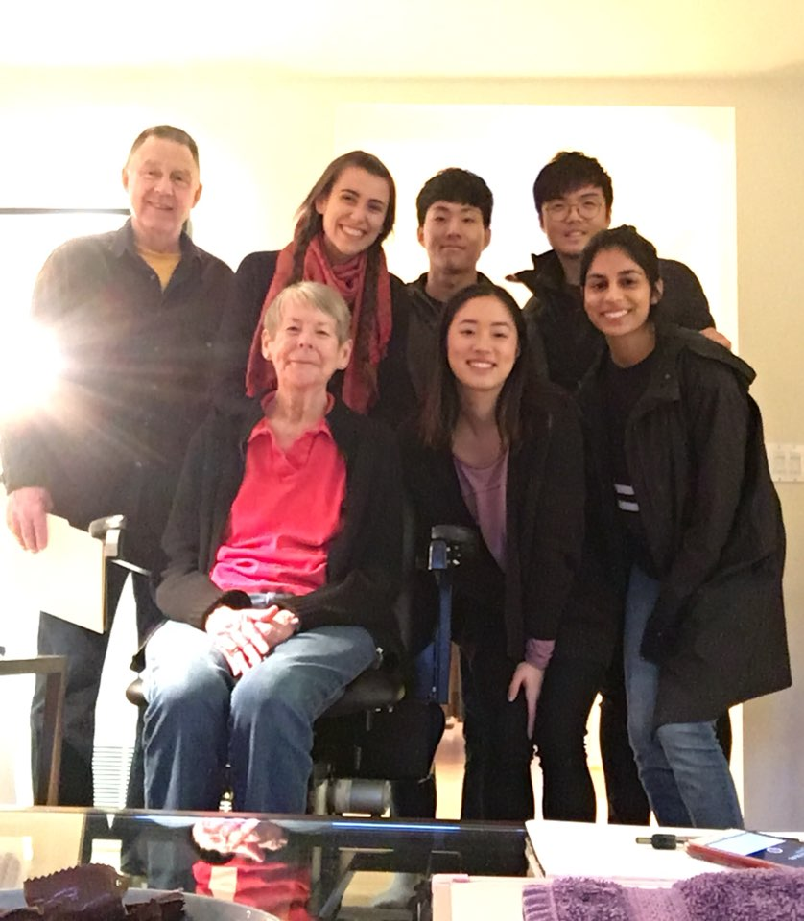
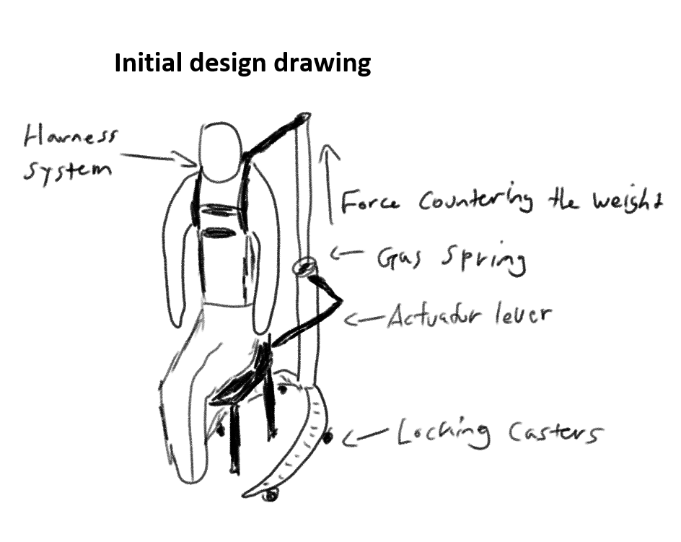
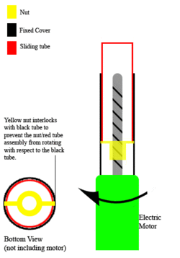
Transferring from Standing to Sitting
¹Hyeongju Choi, Ritika Gupta, Jasmine Hawkins, Sharon Heung, Yoonbo Shim
¹Department of Bioengineering, Human Centered Design and Engineering,
Mechanical Engineering
The Challenge
When Carolee sits down, she “drops” or “falls into place”, which can be uncomfortable and dangerous. Carolee can transfer independently from standing to sitting, but she wants a tool to support safer transfers that reduce reliance on expensive devices and family support.
There is a lack of studies and resources on transfer devices that focus on standing to sitting, and don’t rely on leg and arm muscle strength. The transfer devices that requires specific muscle strength out there are not made for Carolee’s ability.
Design Ideas
Gas Spring (Figure 1)
Hold user's’ weight with the reaction force from a gas spring to prevent falling or plopping during transition from standing to sitting.
Electric Linear Actuator (Figure 2)
- A device that converts the rotational motion of
a motor into linear motion. With this device,
we can make it easier and more independent
for users to transfer from both standing to
sitting and sitting to standing positions.
Resistance Band (Demo)
- A simple, flexible, and affordable mechanism
that could potentially allow users to transfer
from a standing to sitting position.
Figure 1
Figure 2
Vote for your Favorite!
Gas Spring | Electric Linear Actuator | Resistance Band
Next Steps
Decide on a final design to iterate on
Make a proof of concept model
Conduct more research to develop our design
Make a Hi-Fi prototype
Conduct usability testing
Revise our design to reflect feedback
Acknowledgements
Thank you to Carolee, Tom, George, and Kat for your help and cooperation!
Notes:
You can move the headings and sections included in the poster template as you wish. However, your poster should highlight:
The Challenge (use a well polished point of view or need statement, include some description of your need experts, take ample space to make this very clear!)
-- After looking at this section, your audience should have a good idea of what your challenge is AND why it is important!
-- It should be clear from your poster what current solutions include and why they don’t meet your POV
-- Some other sub-sections or sub-headings you might include in this section could be Core Functions (what does your solution need to do to satisfy need), Current Solutions (what exists and why don’t they meet the need), Motivation (add extra emphasis for why this is important), Broader Applications (beyond your need expert, what are the broader impacts or applications of this challenge)
Design Ideas (should be the main focus of poster)
-- This section should highlight your leading 1-3 design ideas
-- Make sure someone can quickly see and describe the main features/innovations of your design by quickly looking at your poster.
-- Remember that the purpose of this design review is to get feedback on your design ideas – what can you put in this section to maximize the amount of useful feedback you can get?
-- Items you might want to highlight include models, sketches, quotes or initial feedback you’ve received, initial prototypes
-- Highlight how your design idea is unique and meets the challenge you outlined above
Next Steps (Where are you headed? What is your goal by the end of next quarter?)
Use this as an opportunity to use positive language and focus on the abilities and expertise of your need experts!
Consider how you will interact with and use the poster as a backdrop to share your design with others. What other props or interactive activities do you want to bring?
Keep text to a minimum (use bullets and lists). Make sure all text is large enough to be read from a distance of 2 meter, nothing smaller than 36 pt font.
Use images, graphs, and tables instead of text whenever possible.
We will print the posters – please do not change the overall size of the poster.

